Slide 1

CAR RENTAL SERVICE DATABASE DESIGN
PROJECT TEAM 1
1. Yao Li
2. Supriya Kumari Kushwaha
3. Samanthaka Manognya Tadikonda
4. Jiayan Wang

Slide 2

TABLE OF CONTENTS
Overview of the Project
Mission Statement and Objectives
Entity-Relationship Diagram (ERD)
Database Design Decisions
SQL DDL Statements
Views for Reporting
Reports and Visualizations
Conclusion

Slide 3
OVERVIEW OF THE PROJECT
Purpose :
Develop a robust relational database to support and enhance the operations of a car rental service.
Scope :
The database will manage critical operations such as customer information, vehicle inventory, rental agreements, payments, and more.
Key Features :
Streamline rental processes to improve efficiency.
Enhance customer service by providing accurate and timely information.
Enable precise tracking of vehicle inventory and payments across multiple locations.
Intended Users :
The system will be utilized by sales staff, managers at rental locations, and data scientists for generating reports and analyzing business performance.

Slide 4
MISSION STATEMENT AND OBJECTIVES
Mission Statement :
To design an efficient database system for car rental services that will be able to manage all information regarding customers, vehicle inventory, rental agreements, and payments for improved customer experience and operational efficiency.
Objectives :
Data Management :To manage data efficiently regarding staff, customers, vehicles, agreements, payments, inventories, insurances, policies, locations, bookings, reviews, and promotions.
Data Retrieval :To enable quick searches across all entities for smooth operations.
Status Tracking :To track the status of bookings and payments for smooth operations.
Reporting : Generate detailed reports on the activities of the staff, customer interactions, vehicle details, rental agreements, and payment statuses.

Slide 5
ERD

Slide 6
DATABASE DESIGN DECISIONS
Staff : Manages rentals and customer interactions. Each staff member is linked to a store and may handle multiple rentals.
Customer : Engages in rentals and provides reviews. Each customer has a membership status.
Car : Represents rental vehicles, tracking details such as status and location. Each car is associated with a store and linked to rentals.
Rental Agreement (CarRental) : Central entity recording all rental details, including staff, car, customer, and store involvement. Connects to payments and reviews.
Payment : Captures financial transactions related to rentals, including methods and statuses. Linked to rental agreements.
Store : Physical locations for rentals, hosting staff and vehicles. Integral to rental operations.
Car Inventory : Tracks vehicle availability and status for efficient allocation.
Reviews : Handles customers feedback on rental experiences.

Slide 7
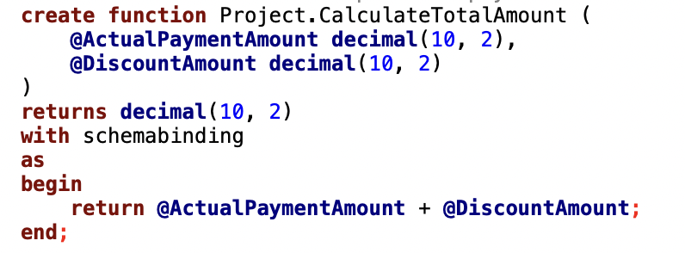

DATABASE IMPLEMENTATION
Create a function to compute the payment TotalAmount by adding ActualPaymentAmount and DiscountAmount

Slide 8
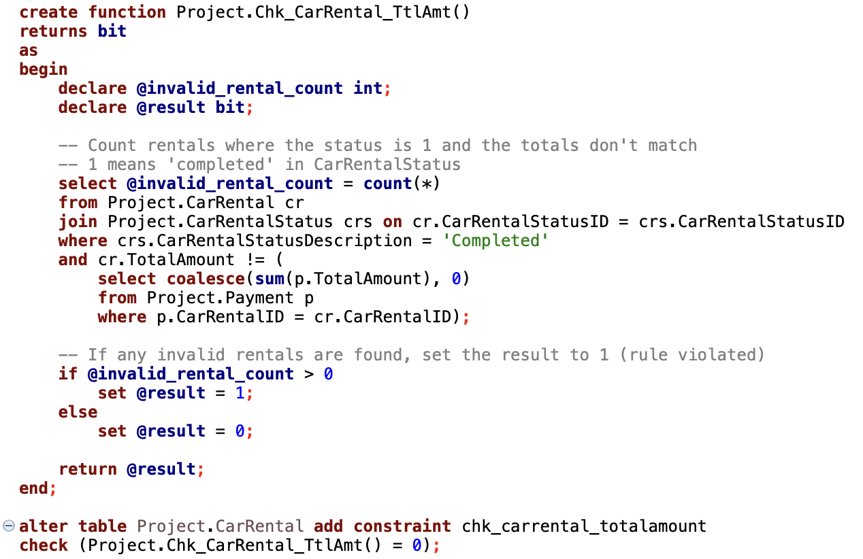
TABLE LEVEL CHECK CONSTRAINT
To check if the TotalAmount of the CarRental is exactly the SUM of TotalAmount of each payment of this car rental.

Slide 9
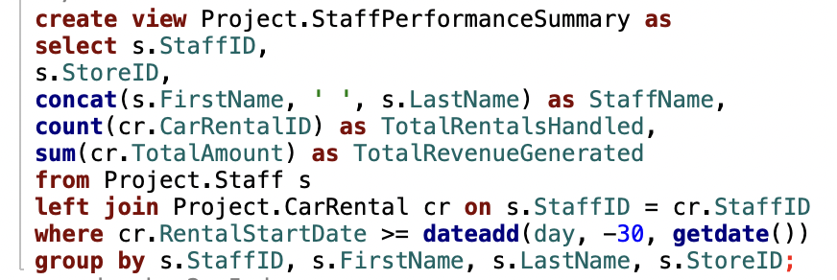
SQL VIEW 1
This view provides insight into staff performance over the last 30 days by summarizing:
1. Total Number of Car Rentals handled by each staff member, helping identify workload distribution.
2. Total Revenue generated from rentals managed by each staff member, offering insights into individual contributions to the company’s earnings.
3. Orders the data by StoreID and Total Revenue (descending) to highlight top-performing staff within each store.

Slide 10
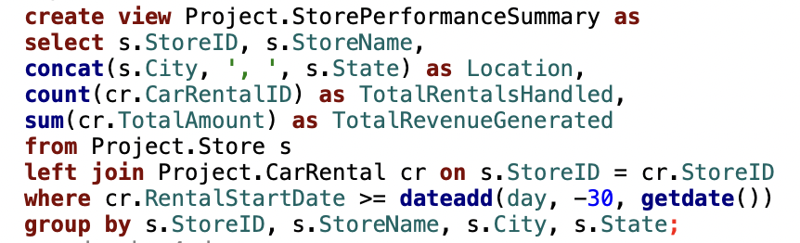
SQL VIEW 2
This view provides insight into store performance over the last 30 days by summarizing:
1. Total Number of Rentals handled by each store, helping identify the workload distribution.
2. Total Revenue generated by rentals from each store, offering insights into the store’s contribution to company earnings.
3. Orders the data by Total Revenue (descending) to highlight top-performing stores.

Slide 11
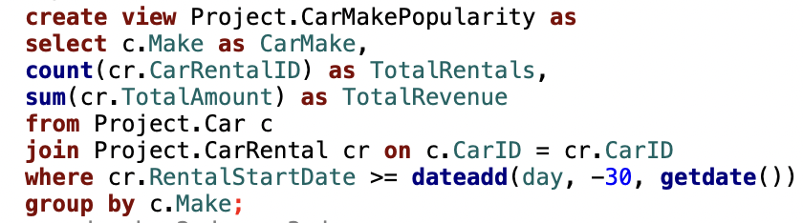
SQL VIEW 3
This view provides insight into the popularity of car makes and their financial performance in the last 30 days by summarizing:
1. Total Number of Rentals for each car make, which helps identify the most frequently rented cars.
2. Total Revenue generated by rentals for each car make, giving an understanding of their contribution to the company’s earnings.
3. Orders the data by the total number of rentals (descending) and total revenue (descending) to highlight the most popular and high-earning car makes.

Slide 12
VISUALIZATION
By PowerBI

Slide 13
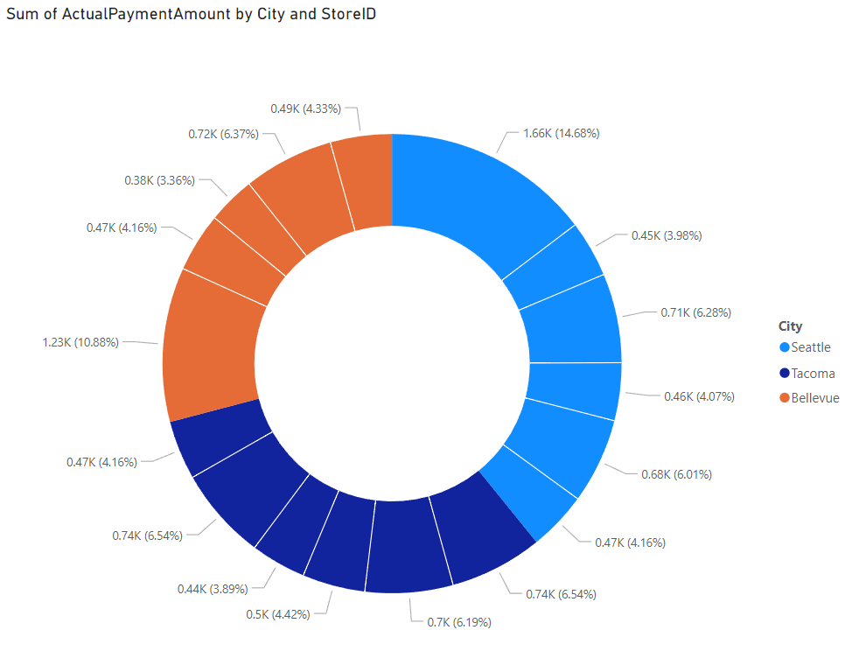

VISUALIZATION 1 : Sum of Actual Payment Amount by City and StoreID 1. Provides geographical insights into revenue performance. 2. Highlights cities or regions with the highest rental demand. 3. Supports location-based strategies, including market expansion and resource allocation.

Slide 14
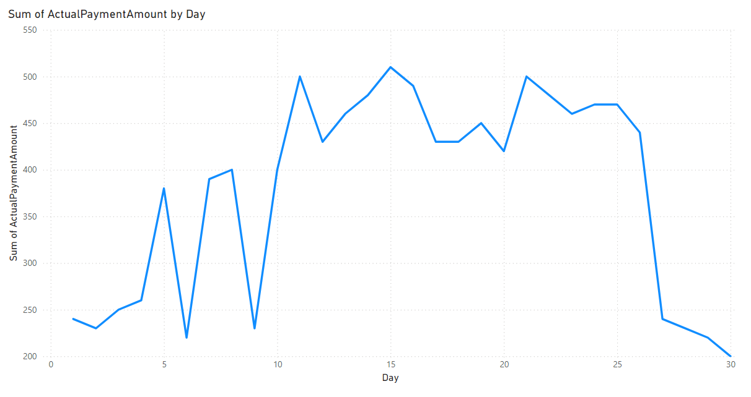
VISUALIZATION 2 : Sum of Actual Payment Amount by Day • Tracks daily revenue trends to identify peak and low-performing days. • Highlights seasonal or daily revenue fluctuations. • Helps managers allocate resources efficiently during peak periods.

Slide 15
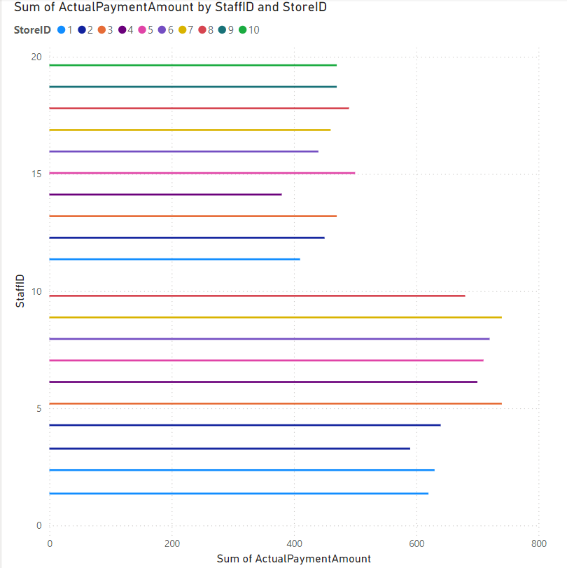
VISUALIZATION 3 : Sum of Actual Payment Amount by StaffID and StoreID • Evaluates individual staff contributions to revenue within their respective stores. • Identifies high-performing employees driving revenue growth. • Assists managers in assessing workload distribution and areas for improvement.

Slide 16
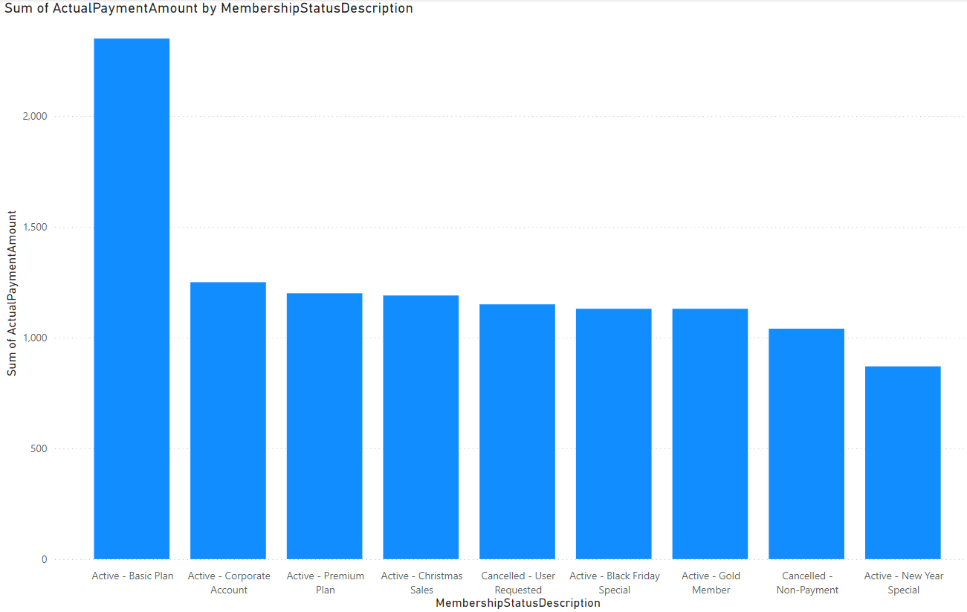
VISUALIZATION 4 : Sum of Actual Payment Amount by MembershipStatusDescription • Analyzes revenue generated by customers with different membership statuses. • Highlights which membership types contribute the most revenue. • Informs strategies to enhance or promote underperforming membership plans.

Slide 17
CONCLUSION
Optimized Operations: Data-driven insights enable better resource allocation, staff performance evaluation, and operational efficiency.
1
Strategic Growth: Store and geographical revenue analysis identify top-performing locations and expansion opportunities.
2
Enhanced Customer Experience: Membership and car popularity trends guide tailored marketing and service strategies.
3
Actionable Insights: Power BI visualizations provide clear metrics for informed decision-making, ensuring long-term business success.
4
This project demonstrates the synergy of robust database design and advanced analytics, driving operational excellence and strategic growth in the competitive car rental industry.
5

Slide 18
THANK YOU!

